Slide 1
Lesson 6 - Don't Repeat Yourself
Mr Mack 2019

Slide 2
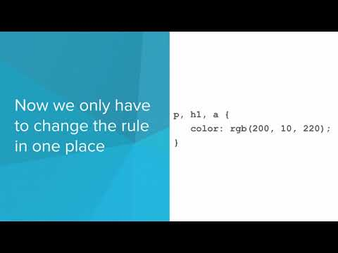
Don't Repeat Yourself

Slide 3
What is the reasoning behind the Don’t Repeat Yourself principle?
It helps you stay under the HTML file character limit
Repeated code makes it harder to read and edit
HTML files with repeated code will take a very long time to load
It makes a more clean and organized website for the user

Slide 4
What are some ways to cut down on repetitive code in your website?
Group together multiple selectors with commas
Strategically plan ahead to make sure the site is coded concisely
Use a div to style multiple elements
All of the above

Slide 5
Example: Styling Multiple Tags
This example shows the code from the slides.
Instead of using three separate rules to specify the same styles, it can be condensed to only one rule!

Slide 6
Example: Style Similar Items with Same Class
This website has three rules that have the same exact styling.
It would be better to use one class to use in every case.
See if you can fix this example to use the DRY principle!

Slide 7
Exercise 4.6.1: Managing Change
Here is the homepage for a baseball fan’s website about baseball. As you can see, she is struggling to get the styling just right.
Link

Slide 8
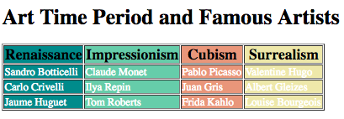
Exercise 4.6.2: Condense CSS Rules
This page’s table is styled using too many CSS rules.
Look carefully through the styles to see which ones are repeats. Create the same stylistic effect by only using 6 CSS rules.

Slide 9
Exercise 5.6.3: Why DRY?
Based on your experience having to read and modify code that didn’t follow the DRY principle, how would you explain to someone else who is just starting to learn web design why DRY is so important?

